Slide 1
Quick Flickr Demo
Tarun Kumar Kalal

Slide 2
Requirements
Create a WPF application
Search photo by text/tags
Get photo collection
List photo in UI

Slide 3
Solution
The Current solution is implemented on .NET Core 6.
The UI is build on WPF.
The Unit test case is developed based on the xUnit and moq framework

Slide 4
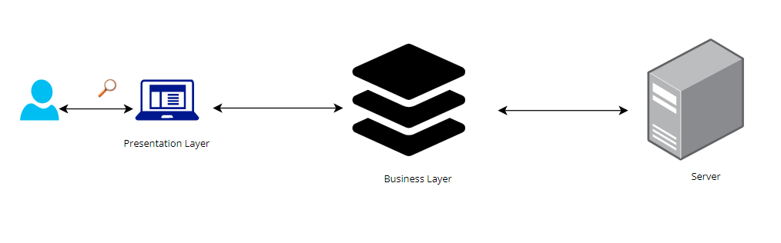
Architectural Diagram

Slide 5
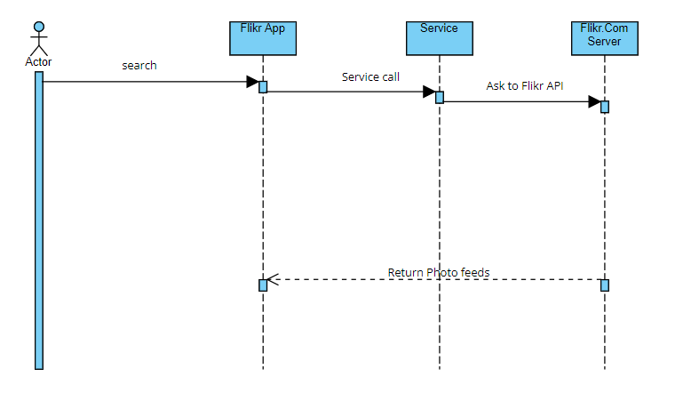
Sequence Diagram
Notes:
https://online.visual-paradigm.com/community/share/untitled-10r9dm6d7i https://online.visual-paradigm.com/app/diagrams/#diagram:proj=0&external=https://smgkybxgon.us-04.visual-paradigm.com/rest/diagrams/shares/diagram/be1cf024-4ff3-4e7c-a834-e738f4e7059b/content&name=Untitled

Slide 6
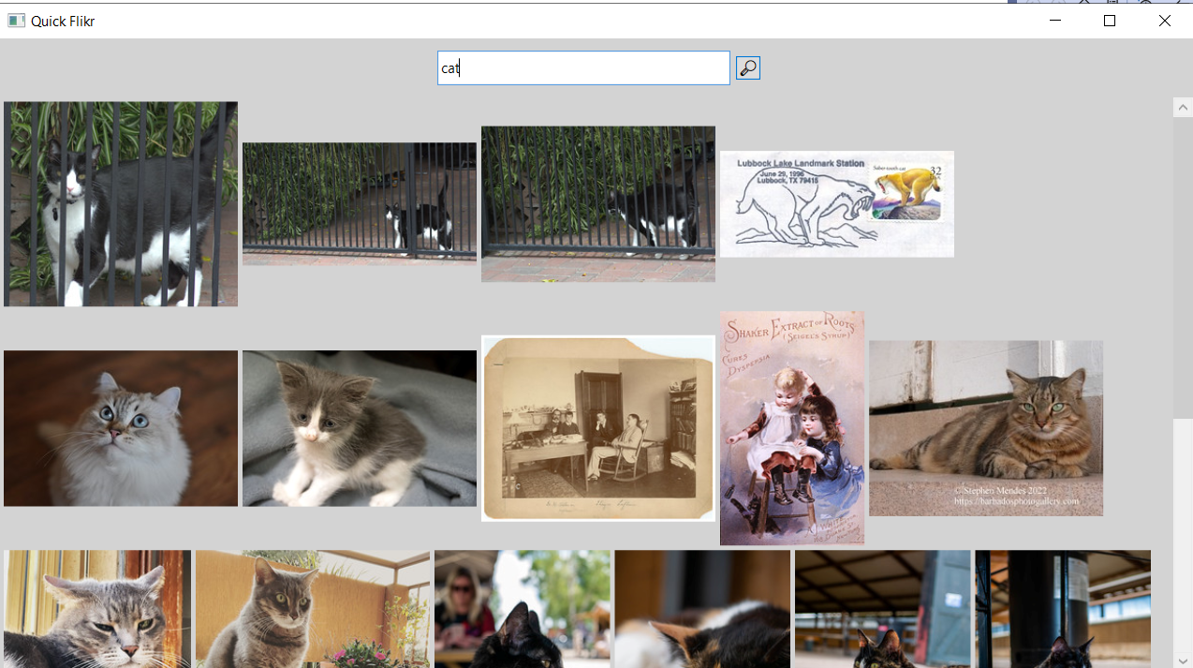
Quick Flikr App

Slide 7
Thank You

